Slide 1
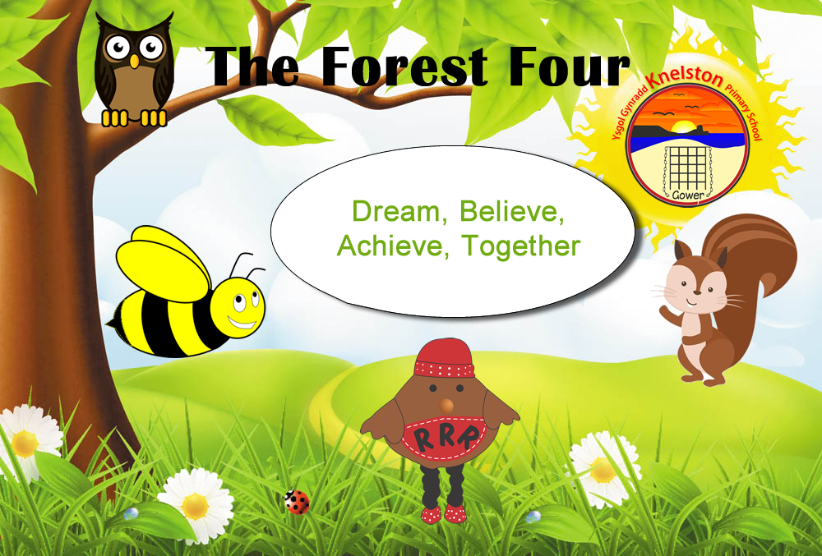
Knelston Primary School
Curriculum for Wales

Slide 2
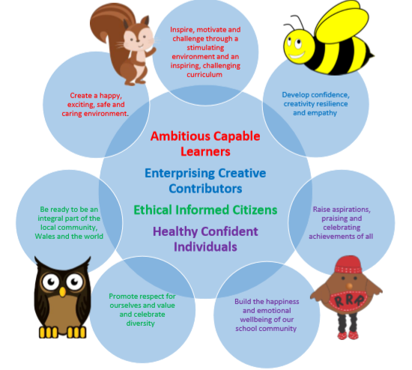
The Four Purposes
Busy Bee is resourceful. We take ownership of our learning and have a growth mindset.
Stick at it Squirrel is resilient. We try our best with new things, work hard and persevere.
Respectful Robin is respectful and encourages us to work well with others and follow the rules.
Wise Owl is reflective and helps us to solve problems and try new approaches.

Slide 3
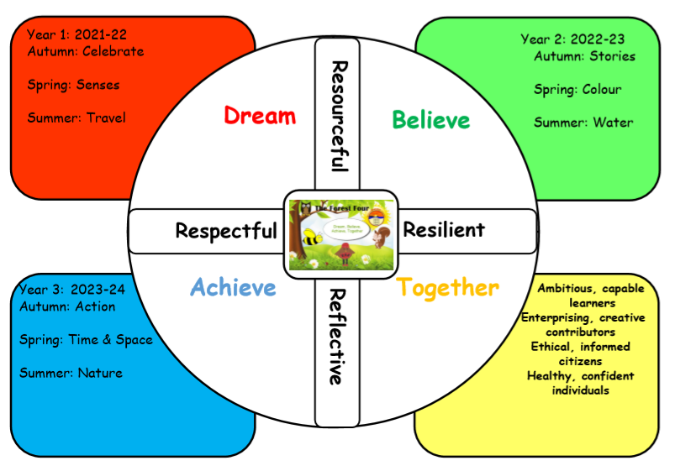
Long Term Plan

Slide 4

Ideas to classroom
Whole school topics
Ideas sharing
Topic Launch event- community involvement
Pupil influenced planning
Activate prior knowledge
We were wondering planning sessions
End of topic celebrations
Polished products and finished pieces
Visits and experiences
Big ideas planned
Evaluate termly plans

Slide 5


Integral Skills
Personal effectiveness Learners should develop emotional intelligence and awareness, becoming confident and independent.
Critical thinking and problem-solving Learners should be supported to ask meaningful questions, and to evaluate information, evidence and situations.
Planning and organising Learners should be able to set goals and make decisions
Creativity and innovation Learners should be given space to be curious and inquisitive, and to generate many ideas.

Slide 6
Cross-curricular skills
Cross-cutting themes
Relationships and sexuality education (RSE)
Human rights
Diversity
Careers and work-related experiences
Local, national and international contexts
Literacy
Numeracy
Digital Competence

Slide 7
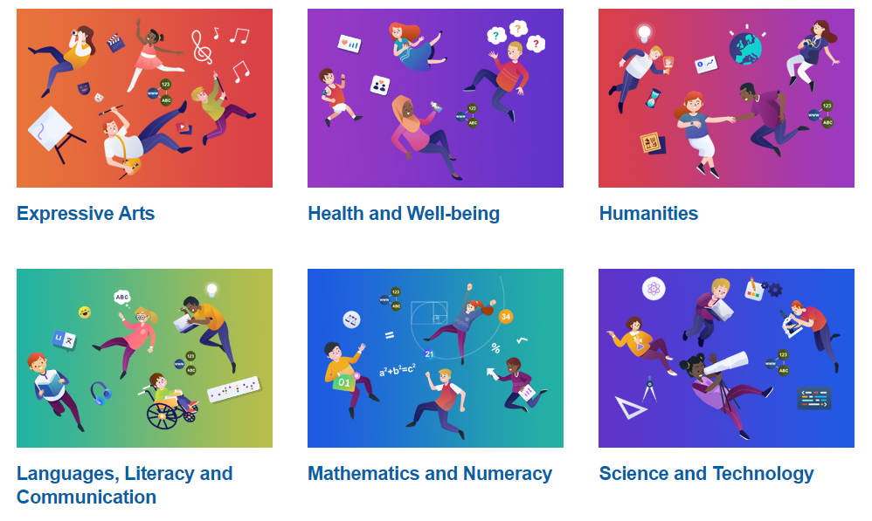
Areas of Learning and Experience

